Slide 1
ITP4512 Enterprise Software Lecture 3 ABAP Dictionary
IT114105 Higher Diploma in Software Engineering

Slide 2
Module Intended Learning Outcomes
At the end of this topic, you will be able to:
perform some common daily operations of major modules of an ERP system;
customise an ERP system using an appropriate programming environment; and
develop programs to support the integration of business transactions among business partners in the supply chain.

Slide 3
Lesson Intended Learning Outcomes
At the end of this topic, you will be able to:
Understand the ABAP Dictionary
Create domain, data element, structure, table and view
Display and update table content

Slide 4
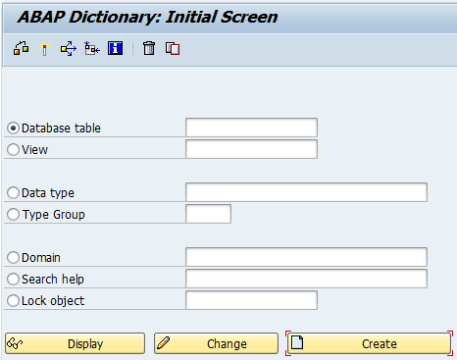
ABAP Dictionary
ABAP Dictionary centrally manages data definitions of data elements, structures and table types
It describes the logical structure of the objects used in application development and shows how they are mapped to the underlying relational database in tables or views
All system components can access activated objects of ABAP Dictionary
SE11

Slide 5
Database Tables and Views

Slide 6
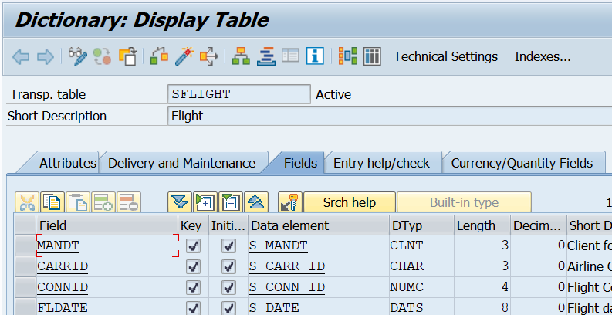
Tables
Once a table is defined in ABAP Dictionary, a table is then created in the database layer
Table in ABAP Dictionary has the same structure as the table in the underlying database
The fields of the table are defined with their data types, lengths and decimal places

Slide 7
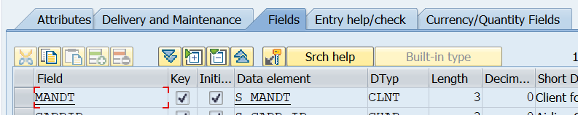
Tables - Fields
Field name - The field name can have a maximum of 16 places and can contain letters, digits and underscores. The field name must begin with a letter
Key flag - Determines whether the field belongs to the table key
key fields are always given initial values
Initial Value Indicator - Set this indicator if a field must have an initial value
Initial value depends on the data type of the field

Slide 8
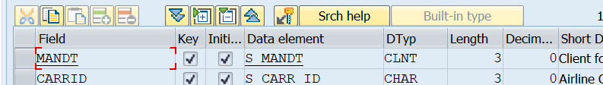
Tables - Fields
Field type - Data type of the field in the ABAP Dictionary.
Field length - Determines the number of valid places in the field.
Decimal places - The number of places after the decimal point, specifying numeric data types.
Short description - Short text describing the meaning of the field.
Data element - The data type, field length, decimal places and short description are determined from the domain of the data element Data Element or Built-in type

Slide 9
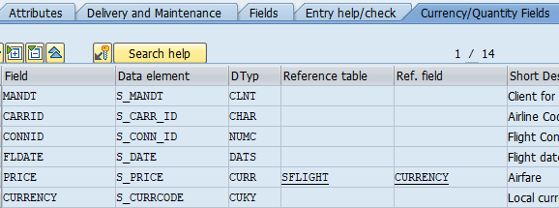
Tables - Reference Fields
Create references to Currency (data type CURR) or Quantity (data type QUAN) Fields
Reference field – currency key (data type CUKY) or unit of measure (data type UNIT)
Reference table – table contains the reference field
Reference field can reside in the table itself

Slide 10
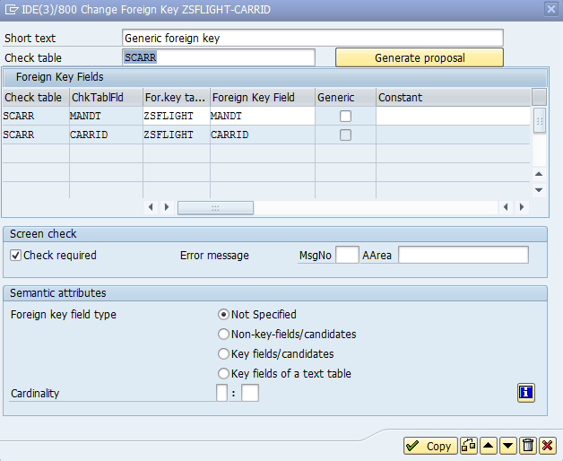
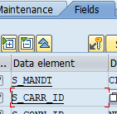
Tables – Foreign Keys
Define relationships between tables and create value checks for input fields

Slide 11
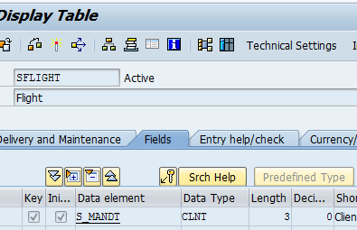
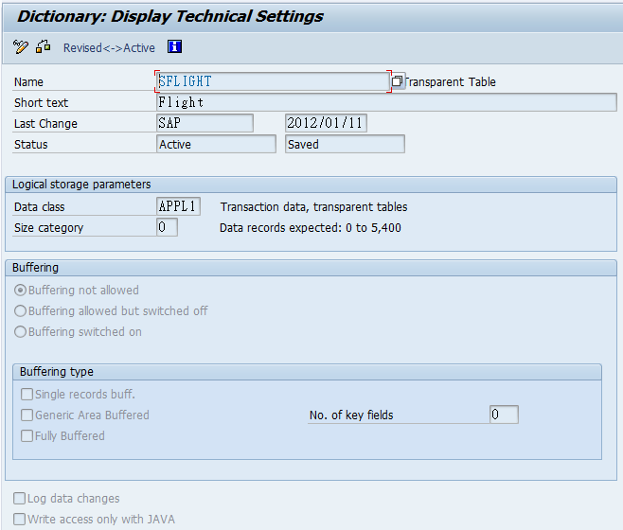
Tables – Technical Setting
Defines how the table is handled when it is created in the database
Specify whether the table is buffered and whether changes to the table's data records are logged

Slide 12
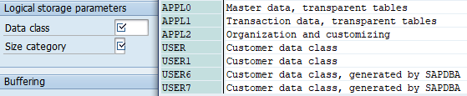
Tables – Technical Setting – Data Class
Each data class corresponds to a physical area in which all the tables assigned to this data class are stored
APPL0 (Master data) - Data which is seldom changed like customer master with name, address and telephone number
APPL1 (Transaction data) - Data that is frequently changed such as the goods in a warehouse, which change after each purchase order
APPL2 (Organizational data) - Customizing data that is defined when the system is installed and seldom changed such country codes

Slide 13
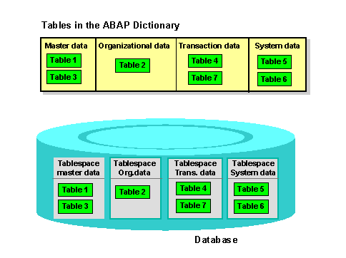
Tables – Technical Setting – Data Class

Slide 14
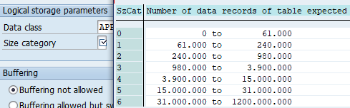
Tables – Technical Setting – Size Category
Defines the expected space required for the table in the database
Each category is assigned a certain fixed memory size in the database, which depends on the database system used
When a table is created, initial space is reserved
If more space is required at a later time due to data entries, additional memory will be added depending on the selected size category

Slide 15
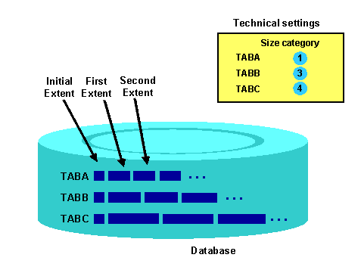
Tables – Technical Setting – Size Category
Selecting the correct size category prevents a large number of very small extents
It also prevents space from being wasted if extents which are too large are created

Slide 16
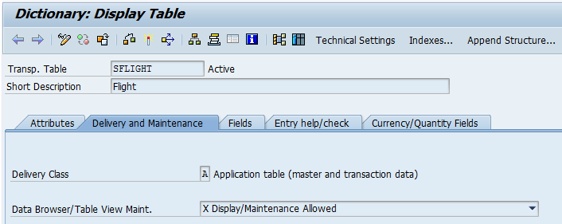
Tables – Delivery and Maintenance
Controls the transport of table data for installation, upgrade, client copy and when transporting between customer systems

Slide 17
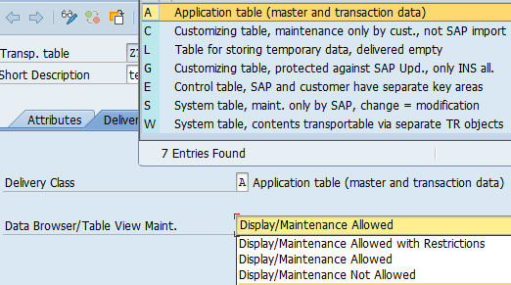
Tables – Delivery and Maintenance
Delivery (development) Class:
A - Application table (master and transaction data)
Data Browser/Table View Maint.:
Display/Maintenance Allowed – enable editing

Slide 18
Process Flow of Creating Tables
Creating Tables and Table Fields
Maintain the technical settings for the table.
The technical settings are a separate object and can be activated and transported separately from the table.
Maintain (if necessary) the foreign key relationships of the table to other tables.
Create (if necessary) secondary indexes for the table.
Choose with the quick info text Save.
A dialog box appears in which you have to assign the table to a development class on the Delivery and Maintenance tab.
Choose an enhancement category
Choose with the quick info text Activate

Slide 19
Views
Once a view is defined in ABAP Dictionary, a view is then created in the database layer
View in ABAP Dictionary has the same structure as the view in the underlying database
4 view types:
Database views are implemented with an equivalent view of the database (Inner Join)
Projection views are used to hide fields of one table
No corresponding object in the database
Help views can be used as a selection method in search helps (Outer Join)
Maintenance views allow you to maintain the data distributed to several tables for one application object at a time (Outer Join)

Slide 20
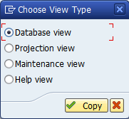
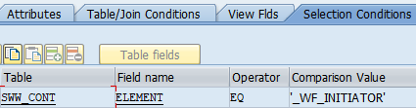
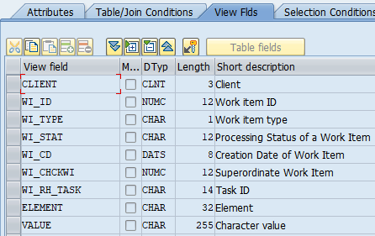
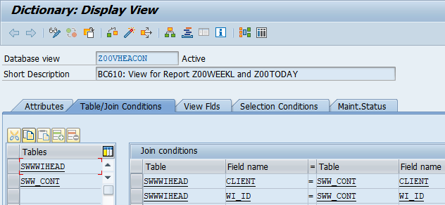
Views

Slide 21
Types

Slide 22
Types
User-defined data type is defined globally in ABAP Dictionary
This type can be used in ABAP programs
Changes to this type automatically take effect in all the ABAP programs
Examples of type categories:
Data elements
Elementary types and reference types
Structures (structured types)
A structure consists of components that also have a type, that is they refer to a type.
Table types
A table type describes the structure and functional attributes of an internal table
A special case is the ranges table types.

Slide 23
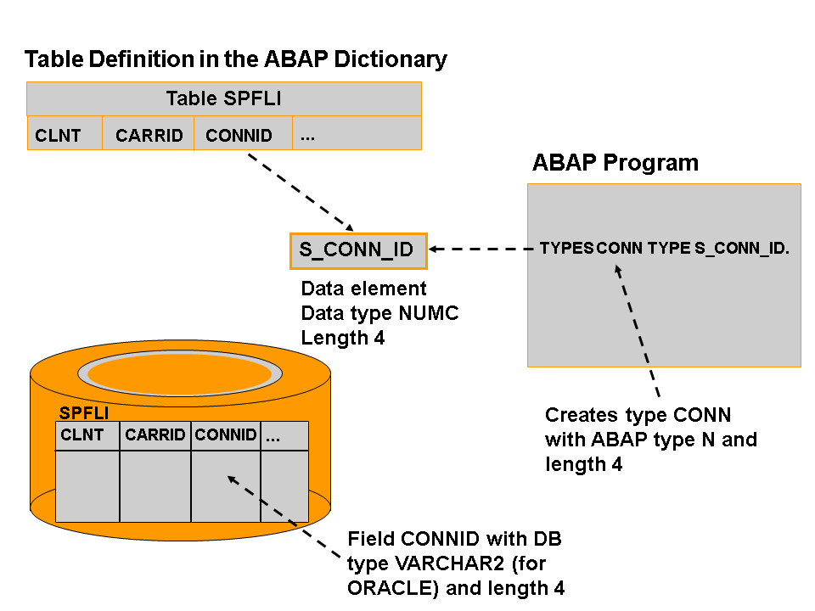
Types

Slide 24
Types
System converts the Dictionary data types of the object fields to the corresponding ABAP data types
Examples:
Type in ABAP Dictionary | Meaning | Type in ABAP Program
CHAR | Character string | c(m)
CLNT | Client | c(3)
CUKY | Currency key | c(5)
CURR | Currency field | p((m+1)/2)
DATS | Date | d
FLTP | Floating point number | f(8)
INT1 | 1 byte integer | b
INT2 | 2 byte integer | s
INT4 | 4 byte integer | i
NUMC | Numeric text | n(m)
TIMS | Time | t
UNIT | Unit key | c(m)

Slide 25
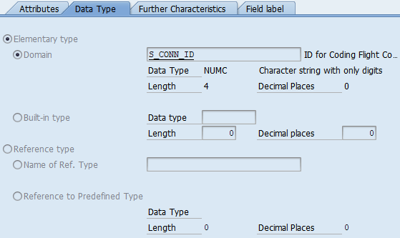
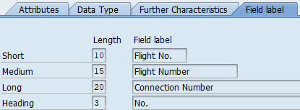
Types - Data Elements
Define the type of a table field, structure component or the row type of a table type
It can also be referenced in ABAP programs with TYPES
Data element information is automatically available to all screen fields that refer to the data element

Slide 26
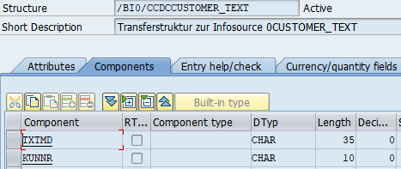
Types - Structure
Types are defined for the components (multiple fields)
Structures are used to define the data at the interface of module pools and screens and to define the parameter types of function modules

Slide 27
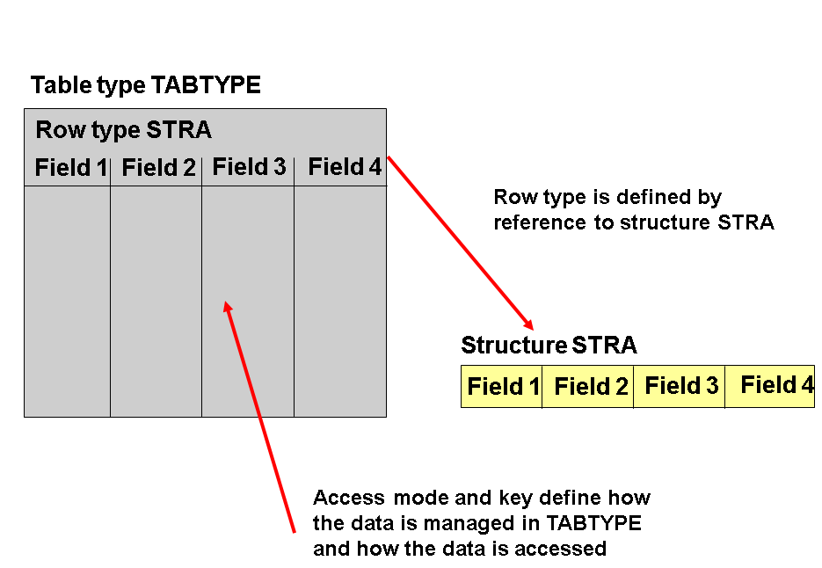
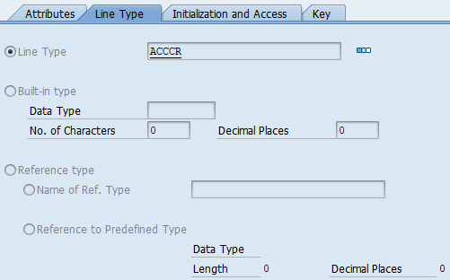
Types – Table Types
Describe the structure and functional attributes of an internal table in ABAP
A table type is defined by:
its line type that defines the structure and data type attributes of a line of the internal table
the options for managing and accessing the data
the primary key and the secondary keys (optional)

Slide 28
Other Object Types

Slide 29
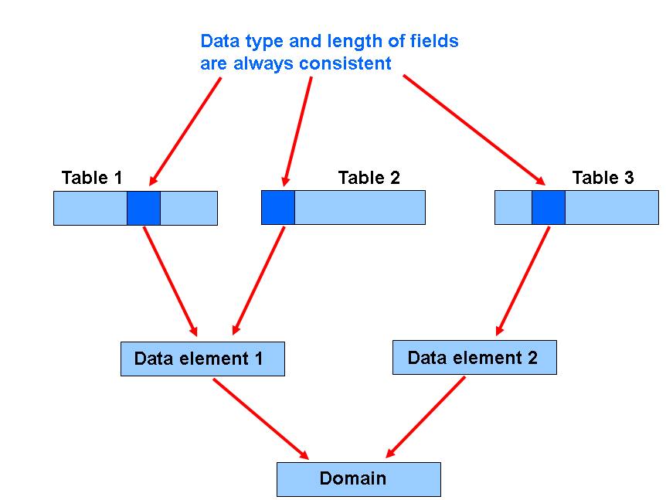
Domain
A domain defines a value range
A domain is assigned to a data element
All table fields or structure components that use this data element have the value range defined by the domain
When you change the domain, the system automatically changes fields or components that refer to this domain
This ensures that the value ranges of these fields or components are consistent

Slide 30
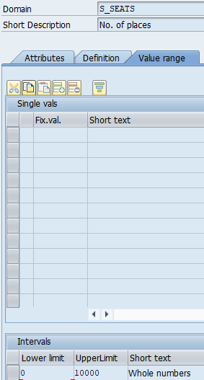
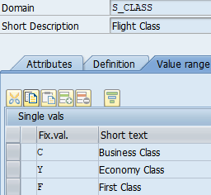
Domain – Fixed Value
Define fixed value intervals either:
by entering upper and lower limits; or
by specifying single values

Slide 31
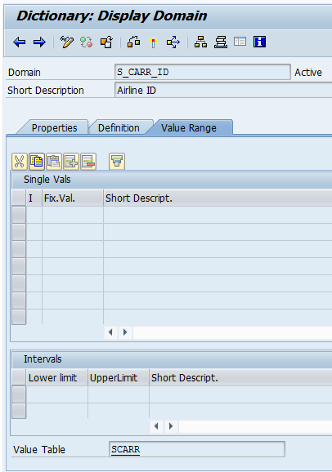
Domain – Value Table
Proposes the value table as check table when trying to define a foreign key for the field
The check against the value table only takes effect when a foreign key has been defined
Example
If you want to define a foreign key for a field referring to S_CARR_ID, SCARR is proposed as the check table

Slide 32
Search Help and Lock Objects
Search help
A list of possible input values that appears for the input
Lock object
Used to synchronize access to the same data by more than one user

